Slide 1


PROJECT TITLE: HOUSE PRICE PREDICTION
Submitted By:
NAME : PENAGANTI SAI
REGNO : 12219418
SECTION : K22UP
ROLL NO : 31

Slide 2
1. INTRODUCTION
The housing market continuously evolves due to factors such as economic conditions, demographic trends, and location dynamics. EDA serves as a crucial first step in tackling complex predictive modeling challenges. This project employs a structured approach to analyze housing data, typically derived from various sources such as public records, real estate listings, and market analyses. By visualizing and interpreting the data, we can identify significant relationships between various features—such as location, square footage, number of bedrooms and bathrooms, age of the property, and local amenities—and house prices.

Slide 3
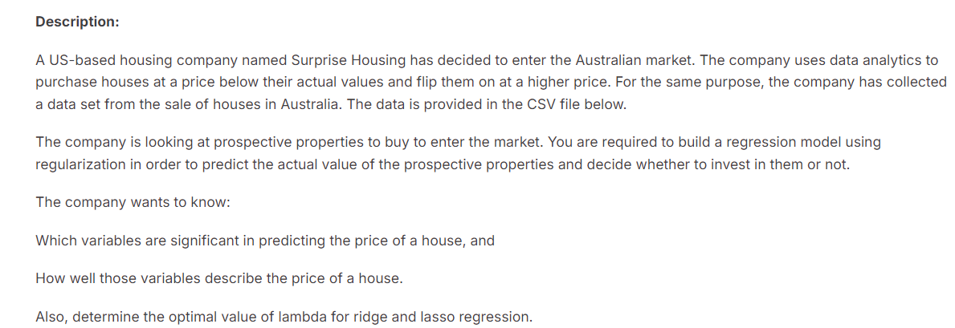
2.PROBLEM STATEMENT

Slide 4
3. METHODOLOGY
EXPLORATORY DATA ANALYSIS(EDA) : Performed correlationships on High correlation columns, univariate analysis and multivariate analysis
Linear regression analysis : It is used to predict the value of a variable based on the value of another variable. The variable you want to predict is called the dependent variable. The variable you are using to predict the other variable's value is called the independent variable.
RMSE : ROOT MEAN SQUARED ERROR
The root mean square error is defined as the measure of the differences between values that are predicted by a model and values that are actually observed.
Ridge regression: It is a regularization approach. The size of the coefficients is reduced and overfitting is prevented by adding a penalty term to the cost function of linear regression
Lasso Regression : It is a method for stopping overfitting in linear regression models by including a penalty term in the cost function. In contrast to Ridge regression, it adds the total of the absolute values of the coefficients rather than the sum of the squared coefficients.

Slide 5
4.RESULT
Data Quality: After cleaning ,the dataset is now complete with accurate and consistent values
Descriptive Statistics: Provides a fundamental understanding of house price from the features and their sale price on year built.
Visualization : Reveals Patterns and trends that will guide further analysis. For example, positive correlation between the two variables.
Linear Regression : Data should be continuous format and it is the relationship btw dependent variable(Price) and independent variable(Features).It can be used to find best fit lines between data points

Slide 6
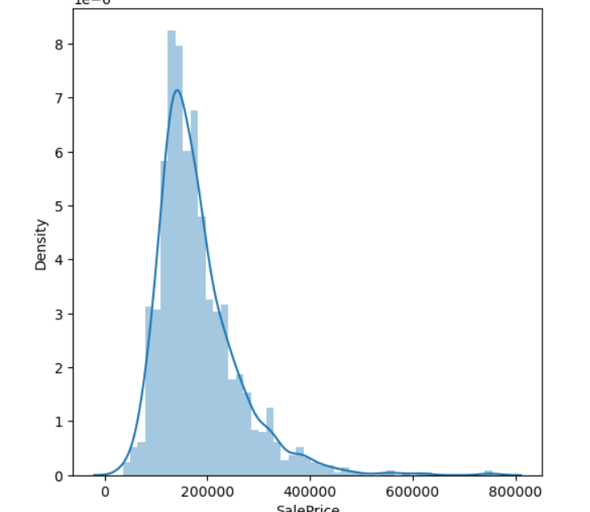
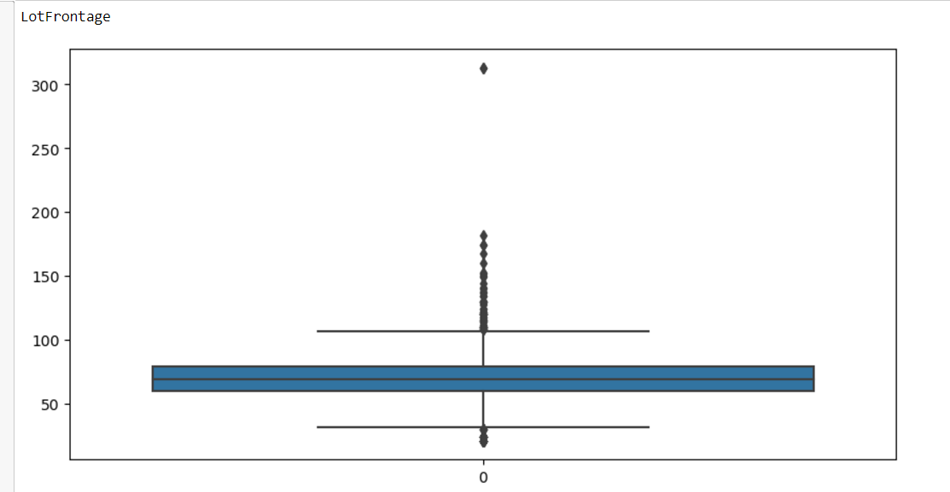
5.ANALYSIS
X-axis: Represents the range of sale prices in the dataset.
Y-axis: Represents the density (or frequency) of the sale prices.
Histogram Bars: Show the frequency distribution of the sale prices.
KDE Curve: A smoothed line that estimates the probability density function of the data.
DISTRIBUTION PLOT
BOX PLOT
Represents the interquartile range (IQR) (middle 50% of the data)
Points plotted outside the whiskers represent outliers, which are unusually high or low values compared to the rest of the data.
The line inside the box shows the median (50th percentile)

Slide 7
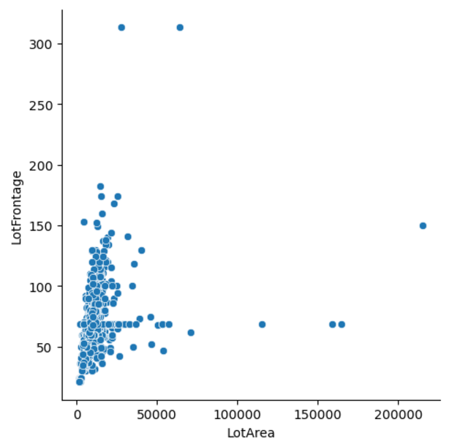
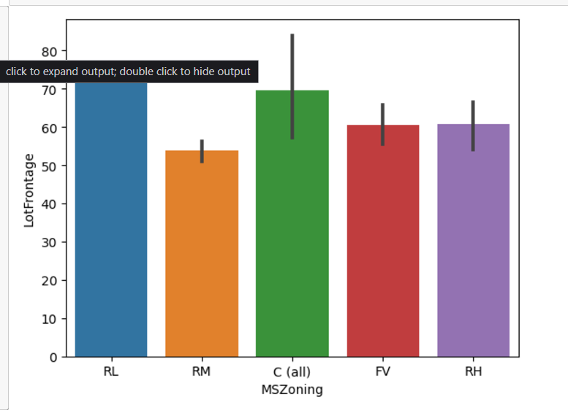
RELATIONAL PLOT
X-axis :Represents the size of the lot for each house.
Y- axis : Represents the street-facing length of each lot.
Each point in the relational plot corresponds to a single observation (house) in the dataset.
BAR PLOT
Each bar shows the mean value of lot frontage for a specific zoning category
The small lines on top of each bar (if present) represent the confidence intervals or standard errors for the mean values.

Slide 8
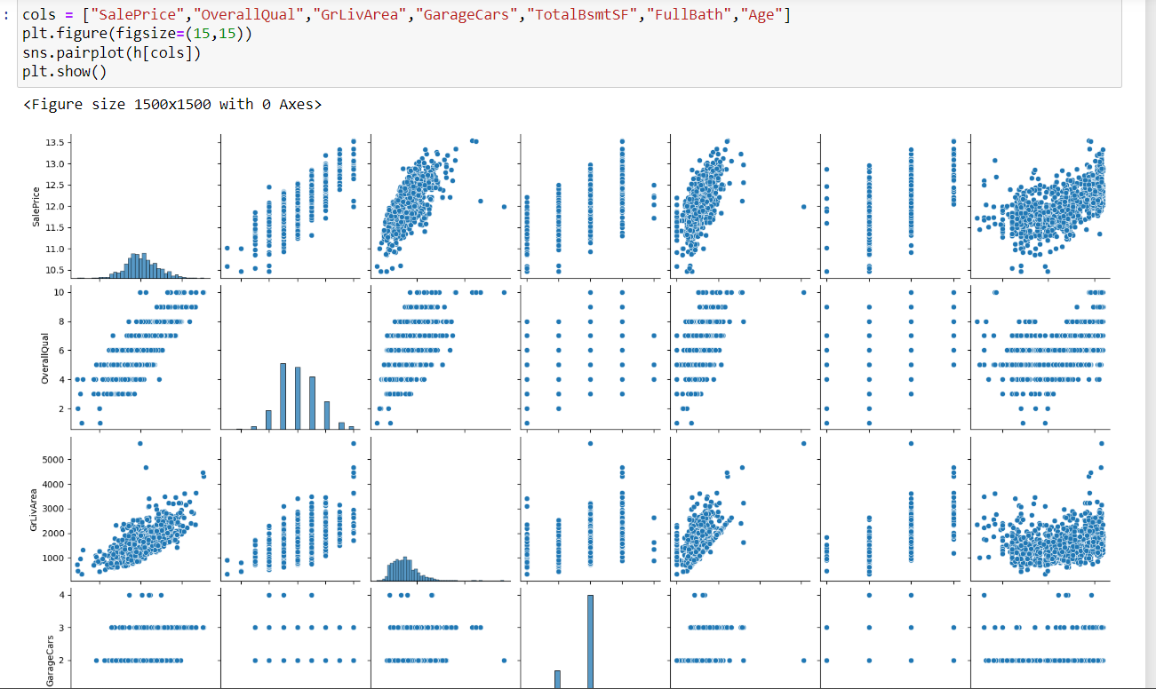
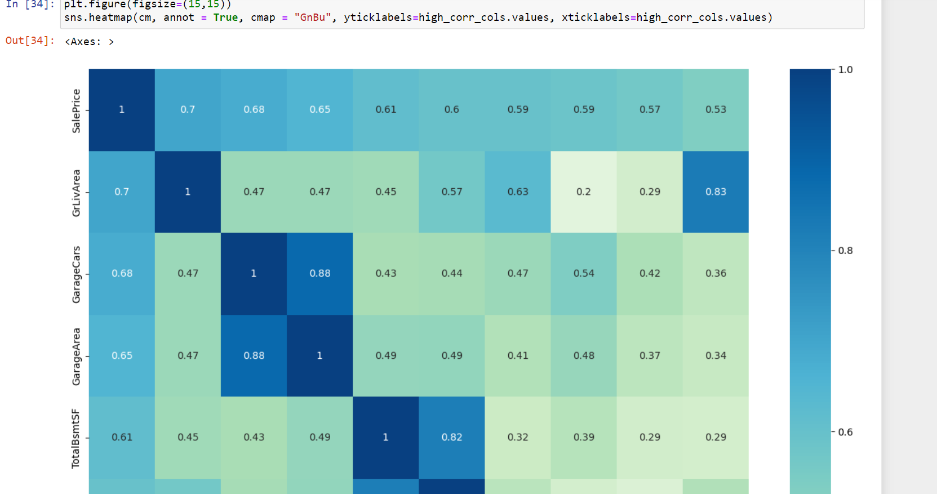
PAIR PLOT
Each scatter plot represents the relationship between two features.
It can Identify patterns and outliers.
HEAT MAP
Both axes list the features in columns with strong correlations
Lighter shades: Weak correlation.
Darker shades: Strong correlation (positive or negative).

Slide 9
6. REFERENCE
https://www.kaggle.com/datasets/srikanthladda/house-price-prediction
https://pandas.pydata.org
https://matplotlib.org

Slide 10


